Slide 1

HTML
Lesson 2

Slide 2
HTML – Font Tag
The <font> tag specifies the font face,
font size, and font color of text.
<font color="blue" size="4" face="verdana">
Some text
</font>

Slide 3
HTML – Hyperlinks (links)
<a href="url">Link text</a>
<a href="http://www.nverner.am" >Visit Nverner</a>

Slide 4
HTML – Hyperlinks (links)
The Target Attribute:
<a href="http://www.nverner.am" target="_blank">
Visit Nverner</a>
Value | Description
_blank | Opens the linked document in a new window or tab
_self | Opens the linked document in the same frame as it was clicked (this is default)
_parent | Opens the linked document in the parent frame
_top | Opens the linked document in the full body of the window
framename | Opens the linked document in a named frame

Slide 5
The Id Attribute:
<p id ="useful" >Useful Section</p>
<a href="#useful" >Visit Useful Section</a>

Slide 6
HTML – Images
<img src= "url" alt= "some_text" >
The <img> tag is empty
<img src= "image.jpg" alt= "Image"
width="304" height= "228" >

Slide 7
HTML – Div
The <div> tag defines a division or a section in an HTML document.
HTML – Span
<span> is very much like a <div> element,
but <div> is a block-level element whereas a
<span > is an inline element.

Slide 8
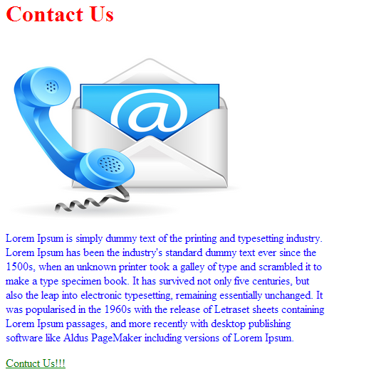
Task:1

Slide 9
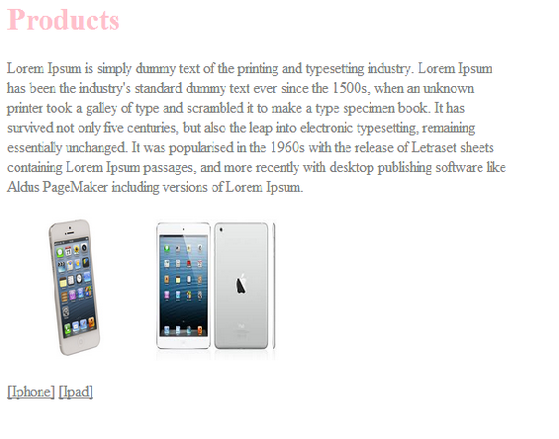
Task:2

Slide 10

Task:3

